Slide 1
Putting the ‘Sec’ in DevSecOps
By: Bill Kiley

Slide 2
What is it?
Dev(elopment)
Sec(urity)
Op(eration)s

Slide 3
The foundation: DevOps
Automation & Testing in the SDLC.
The goal:
  To reduce time & errors

Slide 4
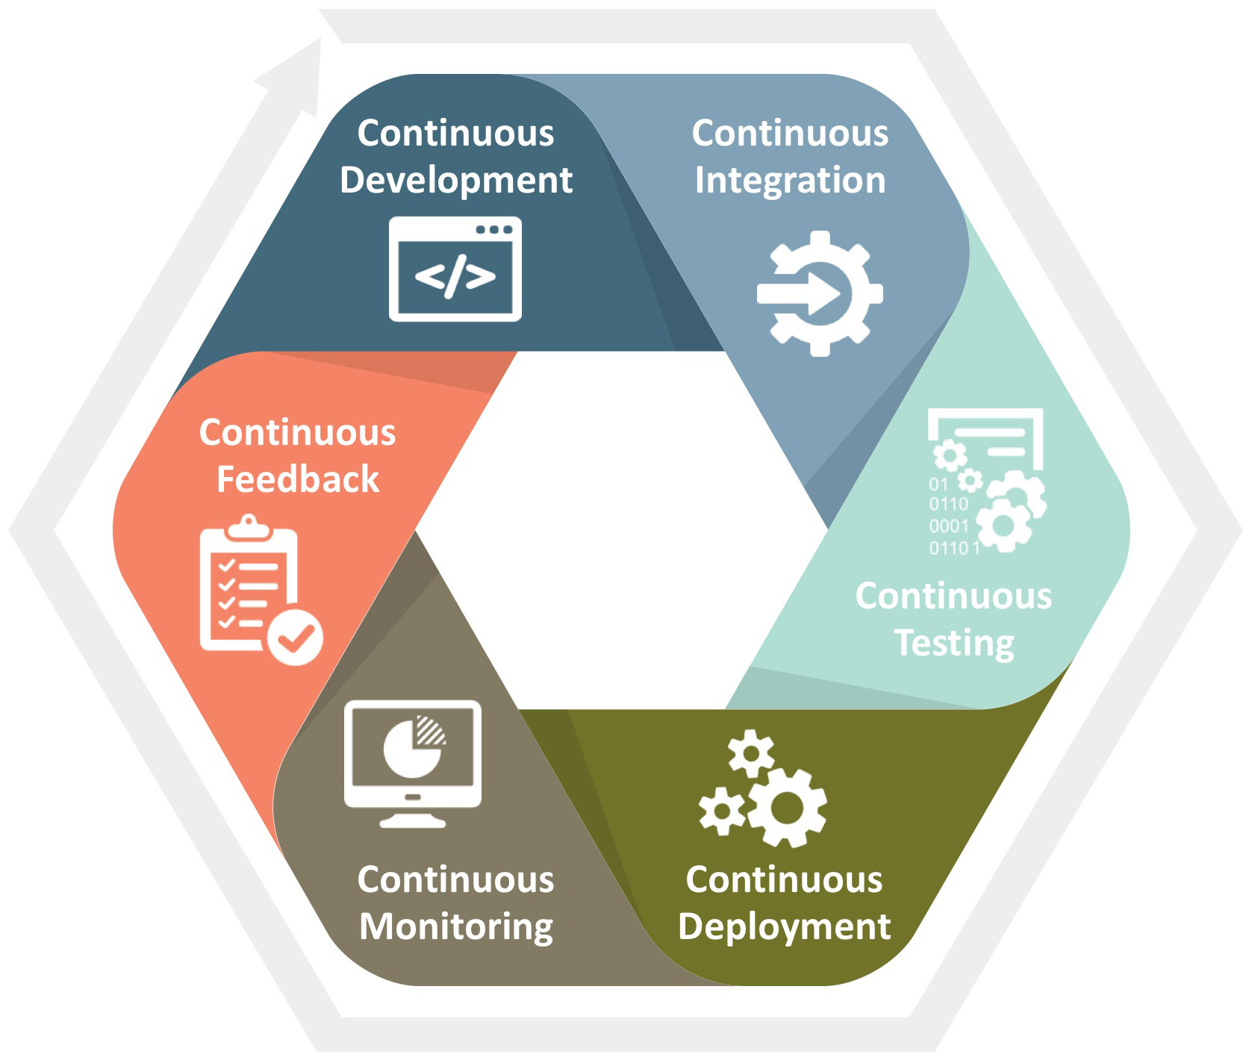
DevOps SDLC

Slide 5
Your SDLC
How do you build?
How do you test?
How do you configure?
How do you deploy?

Slide 6
Adding the Missing Piece: Sec
Design and test…
…but the key: detect and respond

Slide 7
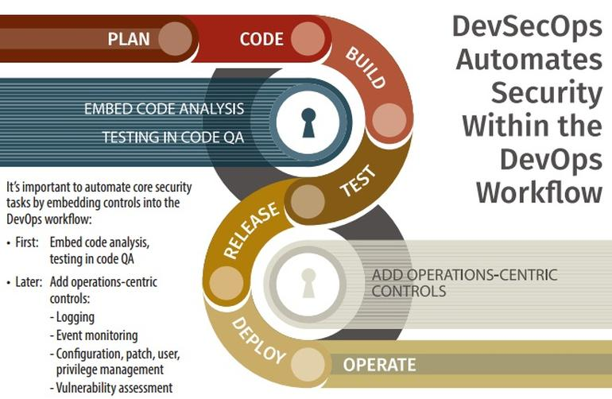

Slide 8
Putting it Together
Develop code
Commit to source control (git)
Build and run unit tests & static code analysis (Jenkins)
Provision test environment and deploy (Chef)
Run full battery of tests against deployed app (Jenkins)
Deploy (if tests pass) to production (Chef)
Monitor and alert (Splunk)

Slide 9
Reducing Technical Debt
What is Technical Debt?
What does that have to do with DevSecOps?

